Slide 1

Steering Committee Meeting
October 18, 2016
WebEx Meeting Recording
Play recording
Collateral Web Q4 Enhancements - Steering Committee Meeting Tuesday, October 18, 2016 3:04 pm | Eastern Daylight Time (New York, GMT-04:00)

Slide 2
Steering Committee Members
Association | Member | Present? Y/N/Rep
FPI | Bevin Morrissey Aaron Clayton Kevin Geissler April Beston Rebecca McFarland Bob Hoffman Charles Branche Brian Ulrich LeeAnne Nikolao Dan Welch | Y Y Y Y Y N Y Y Y Y
AgCountry | Kari Seidel Becky Thibert Sara Helgeson | N Y Y
Farm Credit East | Steve Rickenbacher Ryan Hrobuchak | Y
Farm Credit West | Melissa Gomes James Neeley | Y Y
Northwest | Jacob Ruland Heidi Borlaug | Y Y
Yankee | Kyle Lussier | Y

Slide 3
November Release Content Review
Make Lien Positioning Configurable by ACA
Edit Loan Position from Collateral Analysis
Purchased participations secured by chattel
FEMA Hyperlink for Flood Maps on Buildings Panel
Make Partial Releases Editable
New IRS Requirements for Real Estate Collateral
Notes:
Make Lien Positioning Configurable by ACA
FCE/YNK configured off.
If Lien Positioning is configured off, then this means you can edit the Loan Position from the Collateral Analysis screen.
Edit Loan Position from Collateral Analysis
FCE/YNK only, as they elected to configure Lien Positioning OFF.
Can now edit Loan Position on the Collateral Analysis screen by hovering over the cell for a particular piece of collateral in the column of the loan for which you wish to update the loan position. This will reveal the “Update Relationship” icon. Click on this icon to edit the loan position.
Purchased participations secured by chattel
Feature will allow chattel to secure Long Term Participation Loans for those associations that typically exclude chattel from securing long term loans.
Configurable item by ACA.
FEMA Hyperlink for Flood Maps on Buildings Panel
FCE, YNK and AgCountry Only (is configurable by association)
Real Estate wizard – need to check the first option (“The property includes buildings or improvements”) on the “Check All That Apply” panel.
This adds the “Buildings” panel.
Hyperlink labeled “Search Flood Maps” now present on the “Buildings” panel, brings you to URL linked for searching flood maps.
Make Partial Releases Editable
Previously, once you entered a partial release and saved it, you could not then go back and change anything (values, spelling errors, etc.).
Now, up until you submit the scenario, you can go back and edit any partial releases from the “Partial Release History” tab on the Partial Release wizard.
Can edit the Description, Legal Description, and Release Date for any partial release.
Cannot edit the value if the partial release was done at the detail level.
Can edit the value if the partial release was done at the summary level.
AgC Question: For summary level data, can currently key the Market Value you want to release, but cannot key in zero for the value… Can we now manually key in releasing zero values?
Many times AgC releases a piece of land, but no value associated with the land, which will prevent AgC from using this new functionality.
FPI Response: No, you still cannot release zero values.
Was not part of initial requirements documentation; unsure of difficulty for making this change
AgC to send over business case for this, and FPI will investigate -> AgC ACTION ITEM.
FCW Question: If detail entry, what can you edit?
If have 1 collateral object for Real Estate with 2 separate detail records, each with a different number of acres (40 and 80 acres), and only want to release a portion of the acres for one of the two pieces of real estate (20 of the 80 acres)…
Would need to split the Real Estate out into 3 pieces (40, 20, 60 acres), and release one of them (20 acres detail record would be released).
OR could also use “Split Tract” functionality to break out the second piece of real estate into two different detail records.
FPI to note this as a suggestion for this situation in release notes -> FPI ACTION ITEM
New IRS Requirements for Real Estate Collateral
See next slides
Training of new functionality after release will be handled via release notes, which will be training-oriented and not just a summary of the items included. – FPI ACTION ITEM

Slide 4
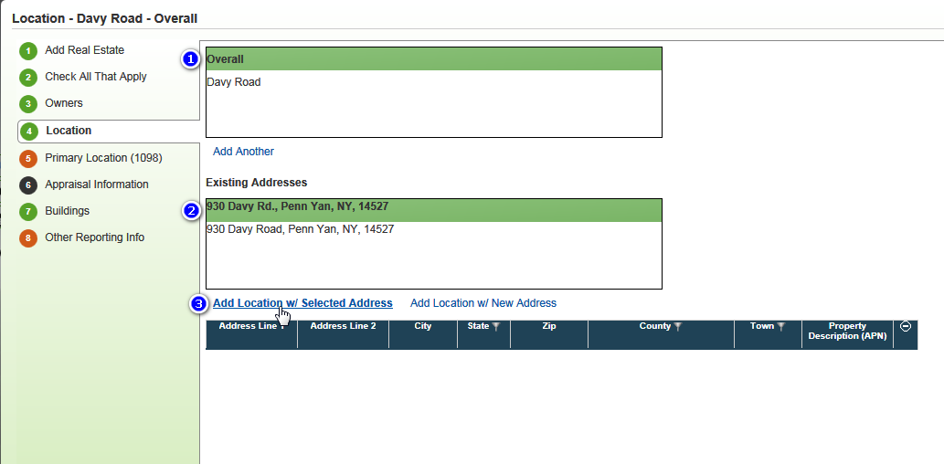
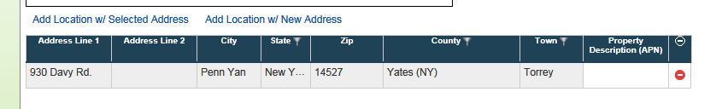
New IRS Requirements for RE Collateral
Notes:
New IRS Requirements for Real Estate Collateral
Addresses situation where you have single piece of collateral that secures two loans with two different primary borrowers, each with a different address… how do you get the correct address for each to go to the 1098?
On Location panel of Real Estate wizard, will now pull in all existing addresses across the group from EmPOWER.
If the address you want to use is the same as one of the addresses in EmPOWER, simply need to select that address, and click “Add Location w/ Selected Address”, which will populate your data grid.
If selecting an address from this list, you cannot change that address in Collateral Web. You would need to go into EmPOWER desktop CRM and update the address there.
Can still add the Property Description (APN) using an address from this list; only editable field besides the ability to delete that address.
FCE Question: Existing addresses pull from EmPOWER CRM screen for each of the primary borrowers?
FPI Response: Yes. FPI will write up a list of all the addresses that actually get pulled from EmPOWER CRM -> FPI ACTION ITEM

Slide 5
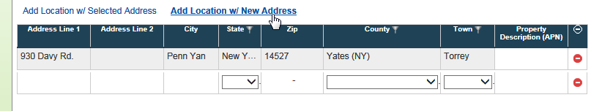
New IRS Requirements for RE Collateral
Notes:
If the address you would like to use is not in EmPOWER, can still add a new address from this panel by selecting the “Add Location w/ New Address” option.
All fields will be open for data entry.
NOTE: Need to either have the full address, OR the Property Description with the County/State filled out.
No validation rules fire on this panel (Location panel) while working in it.
Validation rules fire when you choose to Validate or Submit the scenario.
VALIDATION RULE: Collateral Web validation rule will look for either a legitimate mailing address or Property Description for the row that you chose as the Primary Location to be sent to the 1098 (see next slide for Primary Location).
Makes sure there is an address that has Street Address/City/State/ZIP (that can actually mail to) OR County/State/APN.
Not validating if it has not been touched – Collateral Web in general does not validate any piece of collateral that hasn’t been touched while you are working.
FPI Question: Aren’t staff doing a cleanup right now proactively?
FCW Response: Yes, but the problem is moving forward – will need to do a data scrub every year…
If editing/adding real estate, and it is missing address information, go to validate that scenario, if these business rules are turned on (recommend turning on as soft error, unless any ACA wants it to be a hard error), it will check if for that location, is there an address with all of the correct components to make it a valid address.
Will fail if the address is left totally blank, as well as if the address is not a “valid” address.
Will only pass if one of the two criteria above for a “valid” address exists.
ACA can choose between soft/hard error.

Slide 6
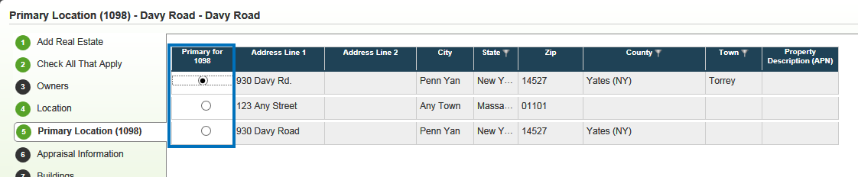
New IRS Requirements for RE Collateral
Notes:
Which address is the Primary Location to flow to the 1098?
Added a second panel to the real estate wizard labeled “Primary Location (1098)”.
Will pull all of the addresses available (from summary and detail items) into the same list on that panel.
The radio button to select which address will be used will default to the first address in that list.
Can change the radio button to select any address from that list to go to the 1098.
Radio button is only thing that can be modified on this panel.
Only need to go to this panel if there are multiple addresses on the “Location” panel, and the first one on in the list is not the address you want to go to the 1098.
If no address on the “Overall” for the Fixture Location panel, will default to the first available detail level address.
FCW Question: At beginning of EmPOWER Web project, there was an item for when appraiser gets appraisal done, it will get put into the system, along with key components from Agware… is this still an item?
FPI Response: Item was discussed for Collateral Remaining project, but ultimately was not implemented, and is not a feature currently available.
FCE Question: Farm property with addresses… what about those without a Number, Street, Town?
FPI Response: 1098 requires the APN for those cases, so use the County, State, and APN for the Property Description.
Removed checkbox saying “No, not same as borrower’s mailing address”. By linking to an existing address in EmPOWER desktop CRM, the address either is the same as the primary borrower’s or it is not, based on the link.
There is a limit on the tax form only allowing up to 39 characters, so be aware that long addresses may get cut off on the form.
FCE Question: One loan secured by two properties (farm + personal residence), how does Collateral Web know which address to choose?
FPI Response: Use the Primary Location panel to select the address you want to use.
Only works if both pieces of property were entered under the same Real Estate object.
FPI to recommend to staff generating the 1098 that if one address matches the primary borrower, choose that address -> FPI ACTION ITEM
NW Question: What happens if staff go in and update an address in EmPOWER CRM… will it automatically update Collateral Web? What if just change of mailing address, don’t want to change the actual collateral record?
FPI Prod Services team plans on adding a warning message for when changing address in desktop EmPOWER so that if that address is being used as a collateral address, ACA staff can then decide if truly should change that address or add a new one.
This warning represents a TRUE link between Collateral Web and EmPOWER… changing a linked address WILL update the address record in Collateral Web.
FCE Question: What if… adding PO Box as new mailing address, but keeping same collateral address?
If adding a new mailing address (PO Box for example), but keeping same collateral address, then in EmPOWER need to create a new address for the PO Box, and then check the new PO Box as the new mailing address.
What happens then in Collateral Web? EmPOWER has the new mailing address, but the record in Collateral Web still has the old address as the mailing address…
1098 gets Mailing Address from EmPOWER still.
If multiple properties used, IRS states that ANY of the property addresses can be used.
FPI to create documentation for different possible situations. – FPI ACTION ITEM
Will take further discussion offline. Contact Bevin with questions.

Slide 7
Discussion of Multiple Scenarios
New Proposal (high-level)
Alert as soon as you attempt to edit object already in another scenario
Add other scenarios’ owner name to Submit hard error
Ability to actually “fix” any overlapping changes (“Undo Changes” option)
ACA parameter to set limit on number of scenarios allowed per scope
Notes:
Time did not allow a discussion of Multiple Scenarios today.
FPI will schedule a new meeting to continue discussing a potential solution for Multiple Scenarios.
Thanks for your patience!

Slide 8

Questions

